Slide 1


Improving the on-call experience: Using Jupyter Notebooks
Justin Moran
New Stars of Data 2020
Notes:
Thank you so much.
I just want to start by thanking Ben and William for organizing up this conference.
Also thank you Chris.
My name is Justin Moran and today we’ll be talking about Improving the on-call experience using Jupyter Notebooks.

Slide 2
Who Am I?
Senior Software Engineer at Microsoft
Azure Data Studio Live Site Tools Team
LinkedIn: https://linkedin.com/in/justinmdotnet
Twitter: https://twitter.com/JustinMDotNet
Email: Justin.Moran@microsoft.com
Notes:
Add Email Address
I’m a Senior Software Engineer at Microsoft. I work on the Azure Data Studio Live Site Tools Team building tools for our Live Site engineers.
Please feel free to send any questions you have to me through any of these contact methods.

Slide 3
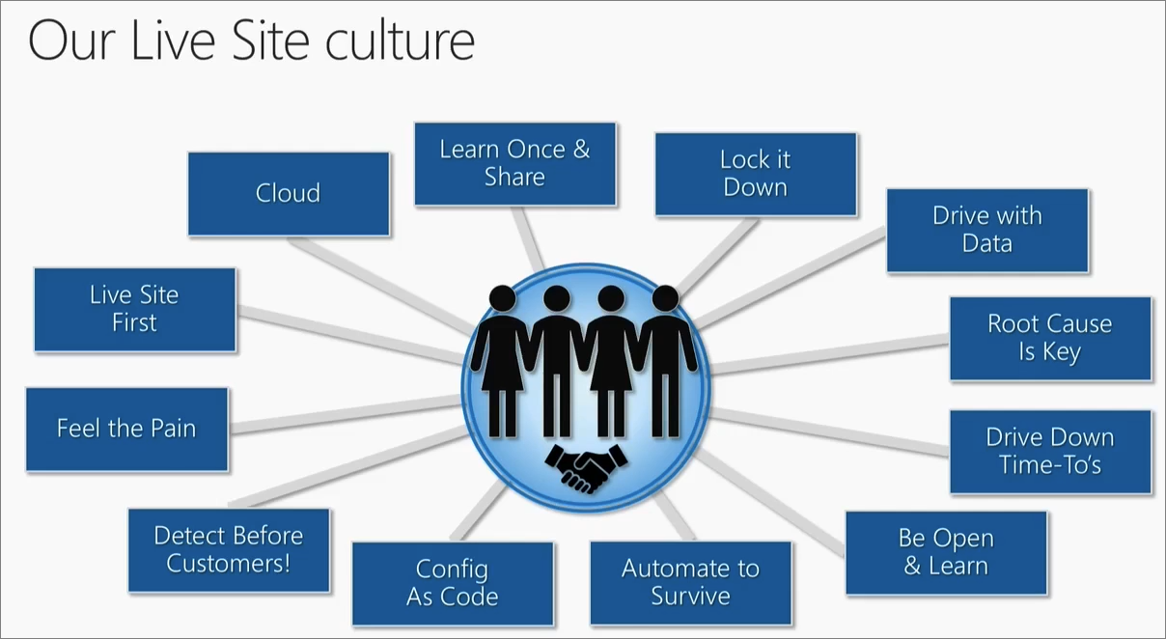
What is Live Site?
Incident Response
Notes:
https://docs.microsoft.com/en-us/azure/devops/learn/devops-at-microsoft/live-site-culture-and-reliability
Live site is Microsoft’s Incident Response to any event in production that results in an impact to customers, such as site outage, latency increase, feature availability, or brand impacts.
My team is specifically focused on building tools and experiences within Azure Data Studio for our incident response teams for internal and external customers.

Slide 4
Dream incident response experience
Automation
Notes:
The dream incident response experience is the one you never have to respond to.
Automation.
Either because an issue doesn’t occur, or an issue has occurred but the system has automatically handled it for you.
But we won’t be talking about this.

Slide 5
Best incident response experience
Notification
Mitigation
Resolution
Team Review
Check Documentation
Notes:
Instead we’ll be talking about the best incident response experience.
The best experience is having documentation around the issue and being able to resolve it quickly without having to do significant research and documentation.

Slide 6
Typical incident response experience
Notification
Research
Mitigation
Document Incident
Resolution
Team Review
Check Documentation
Notes:
Unfortunately, the typical incident response experience looks something like this instead.
An incident starts with receiving notification possibly from a monitor or customer reporting.
The typical starting point is checking the documentation.
If there’s no documentation then the issue will need to be researched in order to understand it and how to mitigate it.
Once that’s done, the issue is then mitigated.
From there, the issue will be documented with it’s cause and solution
Finally it’ll be resolved.
Hopefully, at some point the team will review the incident.

Slide 7
What’s different?
Notification
Research
Mitigation
Document Incident
Resolution
Team Review
Check Documentation
Notes:
What’s different?
The mitigation experience has been extended due to needing to research an issue prior to mitigating it.
In addition, the incident will need to be documented after the mitigation
This means that the system and customer impact lasts longer which negatively impacts customer satisfaction and the company’s bottom line.

Slide 8
What’s different?
Research
Mitigation
Document Incident
Notes:
What’s different?
The mitigation experience has been extended due to needing to research an issue prior to mitigating it.
In addition, the incident will need to be documented after the mitigation
This means that the system and customer impact lasts longer which translates an impact to customer satisfaction and the company’s bottom line.

Slide 9
Typical experience with new team member
Notification – New Responder
Notification – Senior Responder
Communication Sync
Research
Mitigation
Document Incident
Resolution
Team Review
Check Documentation
Check Documentation
Notes:
What happens when you add a new person?
Adding a new person to the team extends the process even further.
The new responder will check documentation
Then they’ll escalate to a senior responder.
After that, they typically will sync up either through chat or a phone call to work the issue together.
They may check the documentation a second time.
They do the research and mitigate together.
They’ll write documentation.
Finally they’ll resolve the issue.
Then, like before, the team will sync later to review the incident.

Slide 10
What’s different?
Notification – New Responder
Notification – Senior Responder
Communication Sync
Research
Mitigation
Document Incident
Resolution
Team Review
Check Documentation
Check Documentation
Notes:
What’s different between the best experience and this?
They’ll typically lean on their senior responder until they have enough experience to resolve issues independently.
In addition, the time between the notification and the mitigation has been extended even further from our best case experience.
Once again, this impacts the customer and the company negatively.

Slide 11
What’s different?
Notification – New Responder
Notification – Senior Responder
Research
Mitigation
Document Incident
Check Documentation
Communication Sync
Notes:
What’s different between the best experience and this?
Adding new responders is expensive.
They’ll typically lean on their senior responder until they have enough experience to resolve issues independently.
In addition, the time between the notification and the mitigation has been extended.
Once again, this impacts the customer and the company negatively.

Slide 12
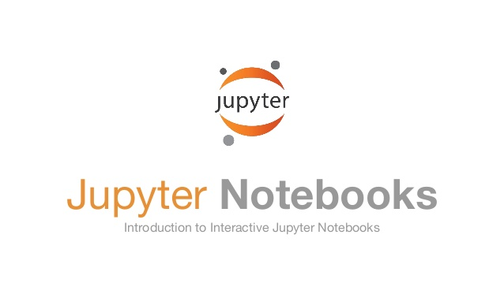
What can we use to solve this?
Notes:
What can we use to solve both of these problems?
Jupyter Notebooks.
Surprise.

Slide 13

How do Notebooks improve the experience?
Documentation
Results are saved
Source Control
Post-Mortem / Follow up / Wash up review
Documentation for every issue
Results
Notes:
How do Juypter Notebooks improve the experience?
Documentation is integrated directly into the incident mitigation.
The code, documentation, and results are saved in a single document with source control as opposed to separate systems.
In addition, the documentation becomes a living document that is constantly updated and improved with each new use.
Post-Mortem and Follow up reviews now have detailed logs for each individual incident.
With better documentation comes faster ramp up for new responders which improves the overall experience.

Slide 14
What are Jupyter Notebooks?
Notebooks that can run executable code and notes
Supported languages
Python 3
T-SQL
Spark
.NET Core Interactive
PowerShell
Kusto Query Language (coming soon)
Other use cases outside of Incident Response
Notes:
What are Jupyter Notebooks?
Jupyter Notebooks are documents that allow notes, executable code, and code results to live in a single place.
The following languages are currently supported with KQL coming very soon.
They have other use cases but we’re not covering those today.

Slide 15
Where can you use them?
Azure Data Studio
Windows
macOS
Linux
.NET Interactive Notebooks
VS Code
Notes:
Where can you use them?
Notebooks are supported in both web and native applications.
Regardless of your operating system, there is a technology that will allow you to use notebooks for your incident response.
Azure Data Studio in particular is provided free by Microsoft and is cross-platform; which is what we’ll be demoing today.

Slide 16

Demo
Notes:
// make check list for tomorrow
// turn off all unnecessary app
// phone on silent
// setup ADS with zoom x 2 and close terminal
Script
<tell story of being new person>
Here’s how notebooks make it easy
// Do you see how easy it was to resolve this incident
<Reinforce the simplicity after solving the issue>
<Add summary>
// As a new person I was able to find documentation, resolve it, run through a set of processes
// and mitigate the issue for the user
// Now I’m going to save these results for my team to review at a later date.

Slide 17
Notebook Summary
Notebooks can run executable code and store notes
Quickly document and troubleshoot new issues
Source Control
Notes:
Just to recap.
Notebooks are an excellent tool for improving the incident response experience regardless of a team’s process.
They are perfect for containing documentation and code that can be executed to resolve high priority incidents quickly and consistently.
In addition, they store the results for follow up and track all changes made using source control.

Slide 18
Experience improvement summary
Diagnose
Diagnose issues quickly within the Notebook
Improve
Improve process with source control
Onboarding
Onboard new responders quickly
Execute
Execute code directly from the document
Document
Save results within the documentation
Notes:
How do they improve the experience?
Well they allow us to diagnose issues quickly within the notebook
Execute the code directly from the document
Save the results within the document
Improve the documentation with source control
And onboard new responders quickly through better documentation
Everything lives in one place.
Which is why you should use Jupyter Notebooks.

Slide 19
Getting Started
Azure Data Studio
http://Aka.ms/azuredatastudio
https://docs.microsoft.com/en-us/sql/azure-data-studio/notebooks-guidance?view=sql-server-ver15

Slide 20

Q&A
Image from AndreyPopov/iStock/Getty Images Plus

Slide 21

Special thanks to
Notes:
Special thanks to Redgate for sponsoring this event.
Also thanks to Ben and William for organizing this event.

Slide 22
Contact Info
Senior Software Engineer at Microsoft
Azure Data Studio Live Site Tools Team
LinkedIn: https://linkedin.com/in/justinmdotnet
Twitter: https://twitter.com/JustinMDotNet
Email: Justin.Moran@microsoft.com
Notes:
Here is my contact info again. Feel free to send any questions you have to me through any of these contact methods.

